Slide 1
BIG MART
SALES PREDICTION
By Tram Vu

Slide 2
Introduction
Aim: Predict sales of 1559 products across 10 Big Mart stores based on 2013 sales data
Input:
Product properties
Store info
Output: sale volume of a particular product in a specific store

Slide 3
Introduction
Product properties
Variables | Description
Type | Product category
Fat content | Low fat or not
Visibility ratio | Visibility* of a product in a particular store as compared to mean visibility of that product across all stores Visibility: % of product display area to total display area
Maximum retail price | Listed price of product
Store info
Variables | Description
Size | Store’s covered ground area
Location type | Type of city which store is located
Type | Grocery store or (some sort of) supermarket

Slide 4
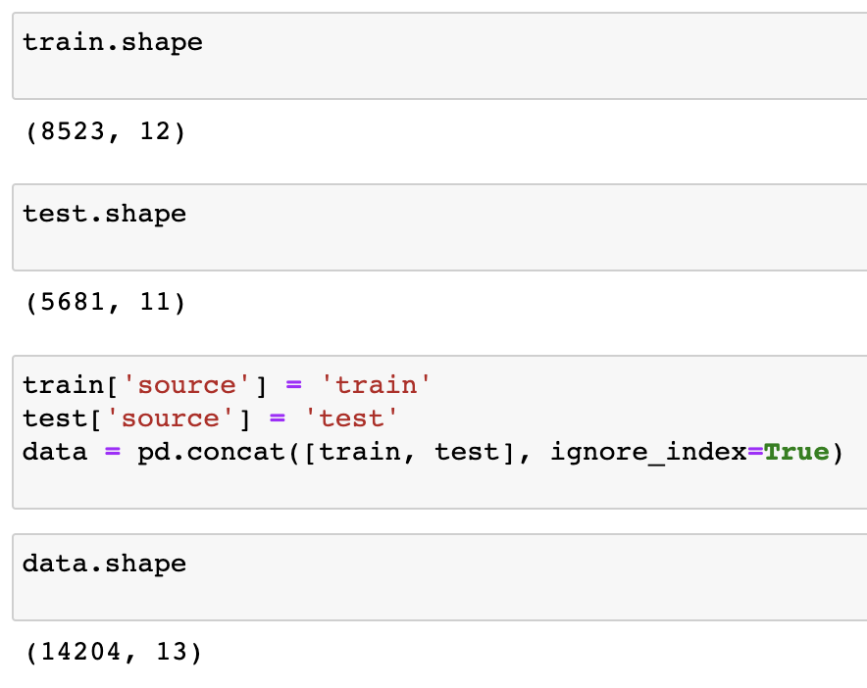
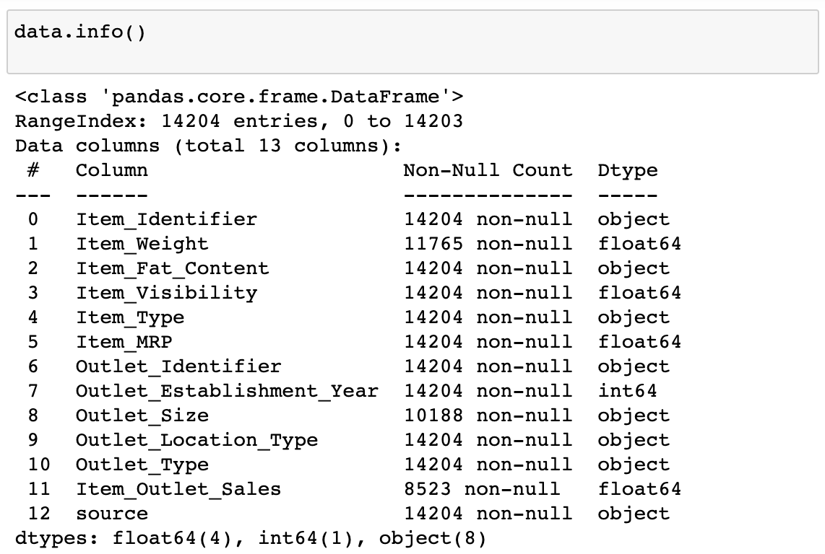
What does the dataset look like?
An initial look

Slide 5
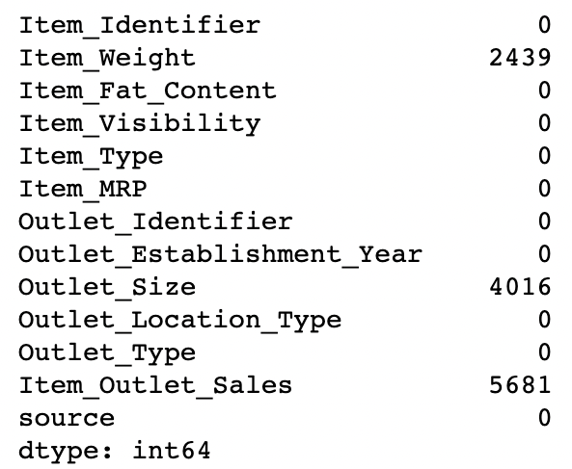
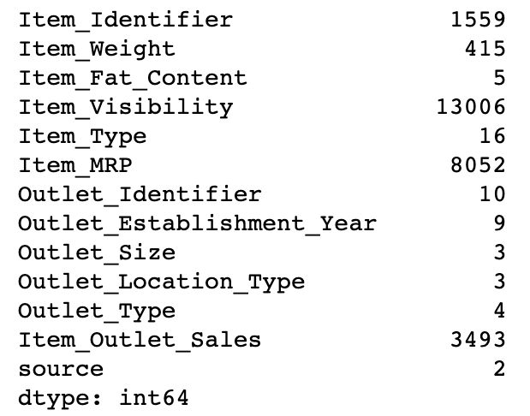
What does the dataset look like?
Null values & Unique value
Null values
Unique values

Slide 6
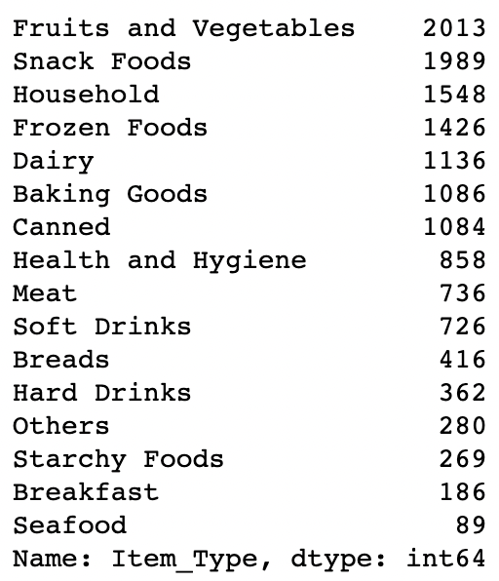
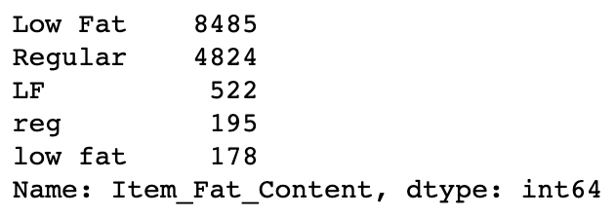
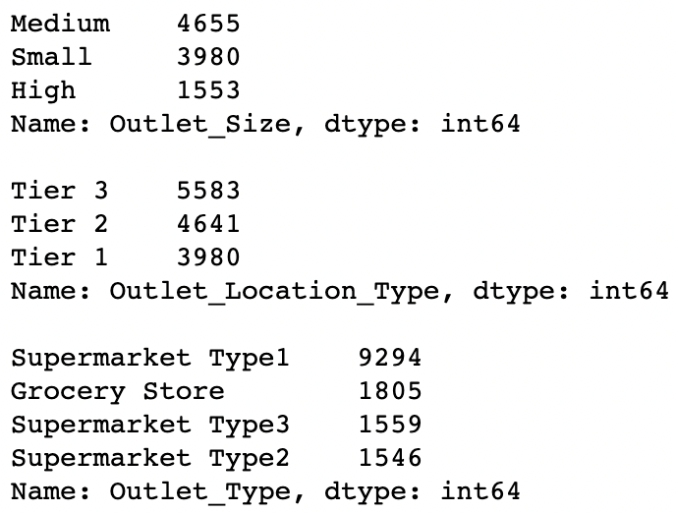
What does the dataset look like?
Unique values
Item_type
Item_Fat_Content
Outlet_size
Outlet_Location_Type
Outlet_Type

Slide 7
Data cleaning
#1. Check & clean duplications
#2. Fill null values
#3. Adjust abnormal values

Slide 8
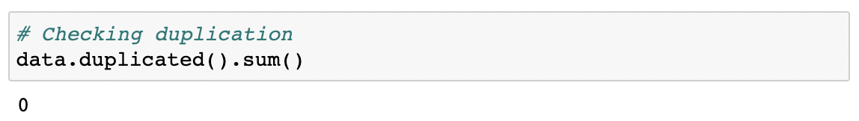
Data cleaning
Check & clean duplications

Slide 9
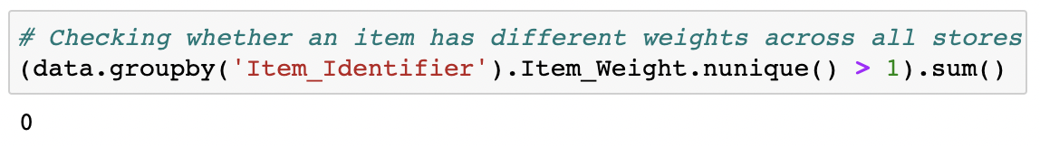
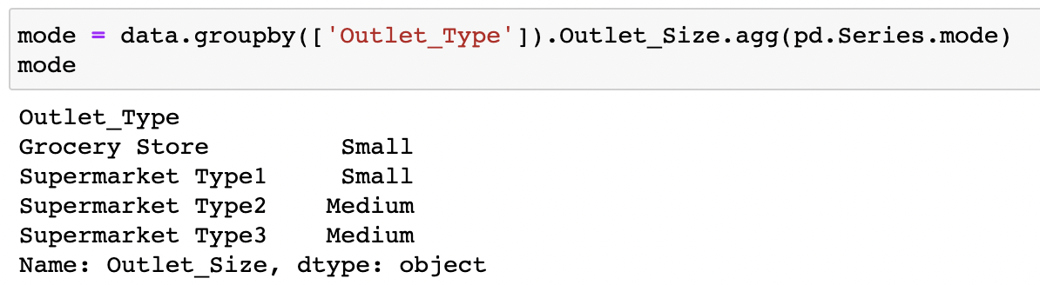
Data cleaning
Fill null values
Product weight: Fill null values by values of same product
Outlet size: Fill null values by mode in each Outlet type

Slide 10
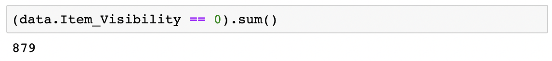
Data cleaning
Fill abnormal values
Visibility: Fill visibility of which value is 0 by mean of visibility of each product

Slide 11
Feature engineering
#1. Create Visibility ratio
#2. Group Product type
#3. Format Fat content
#4. Define Year of operation
#5. Convert categorical variables to binary variables

Slide 12
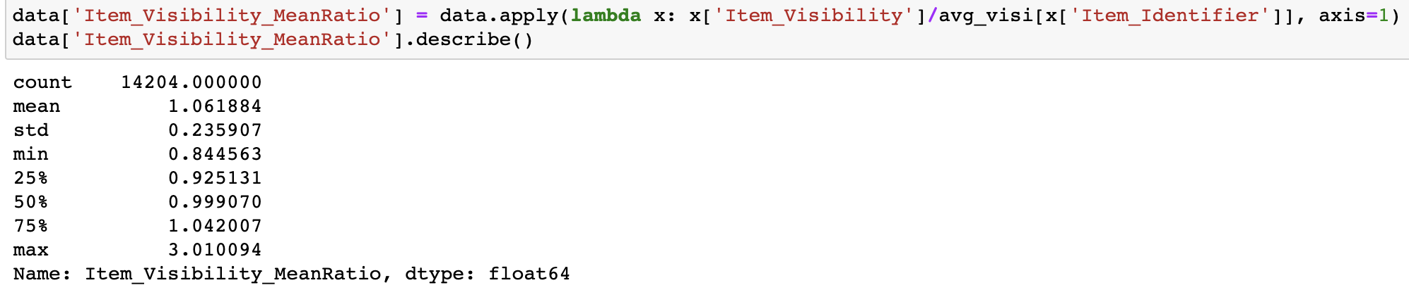
Feature Engineering
Create Visibility ratio
The visibility of an item in a particular store as compared to the mean visibility of that item across all stores
→ showing how much important the item is to that store as compared to other stores

Slide 13
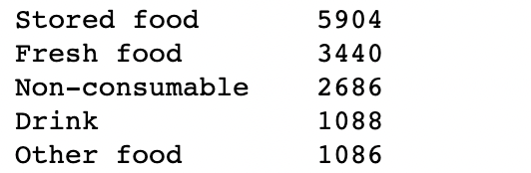
Feature Engineering
Group Product types
Before grouping
After grouping

Slide 14
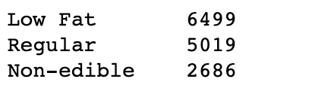
Feature Engineering
Format Fat content
There are 2 types of fat content: Low & Regular.
Only products belonging to Food and Drink categories can have fat contents.
→ Create a new value (non-edible) for Non-consumable category
Before grouping
After grouping

Slide 15
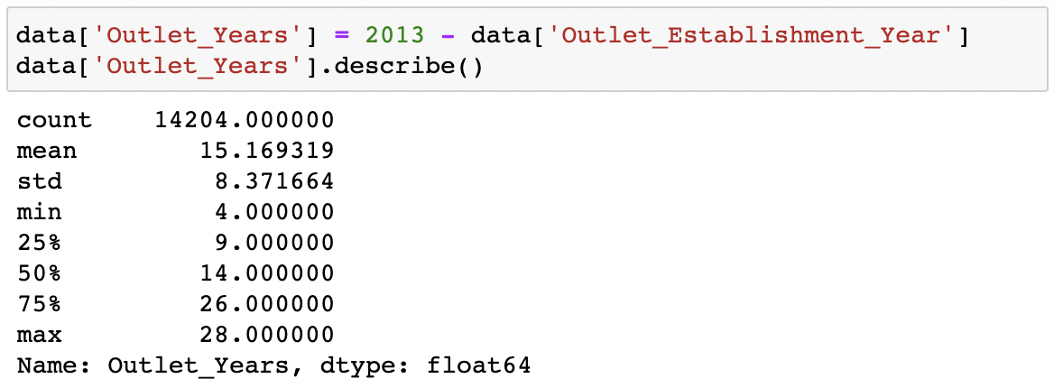
Feature Engineering
Define Year of operation

Slide 16
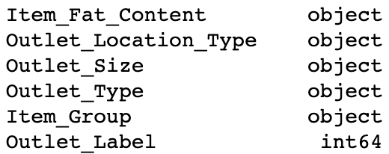
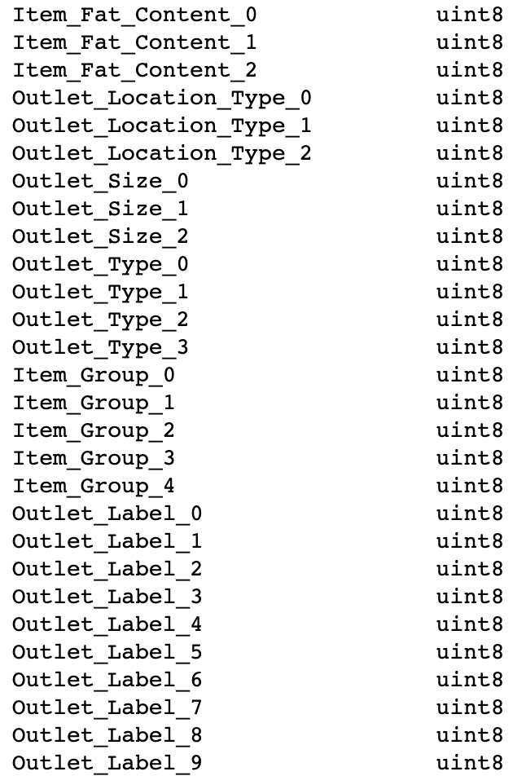
Feature Engineering
Convert categorical variables to binary variables
Before
After

Slide 17
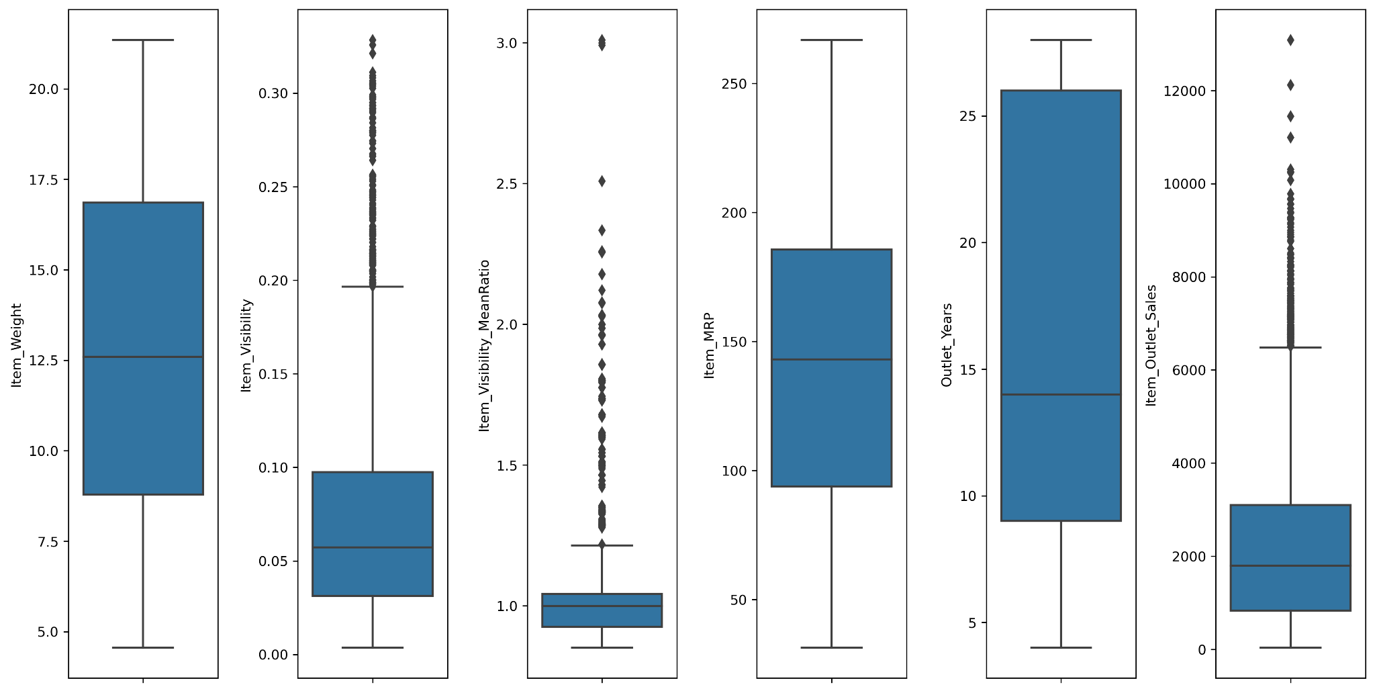
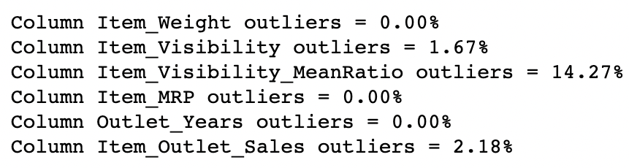
Feature Engineering
Final look on data

Slide 18
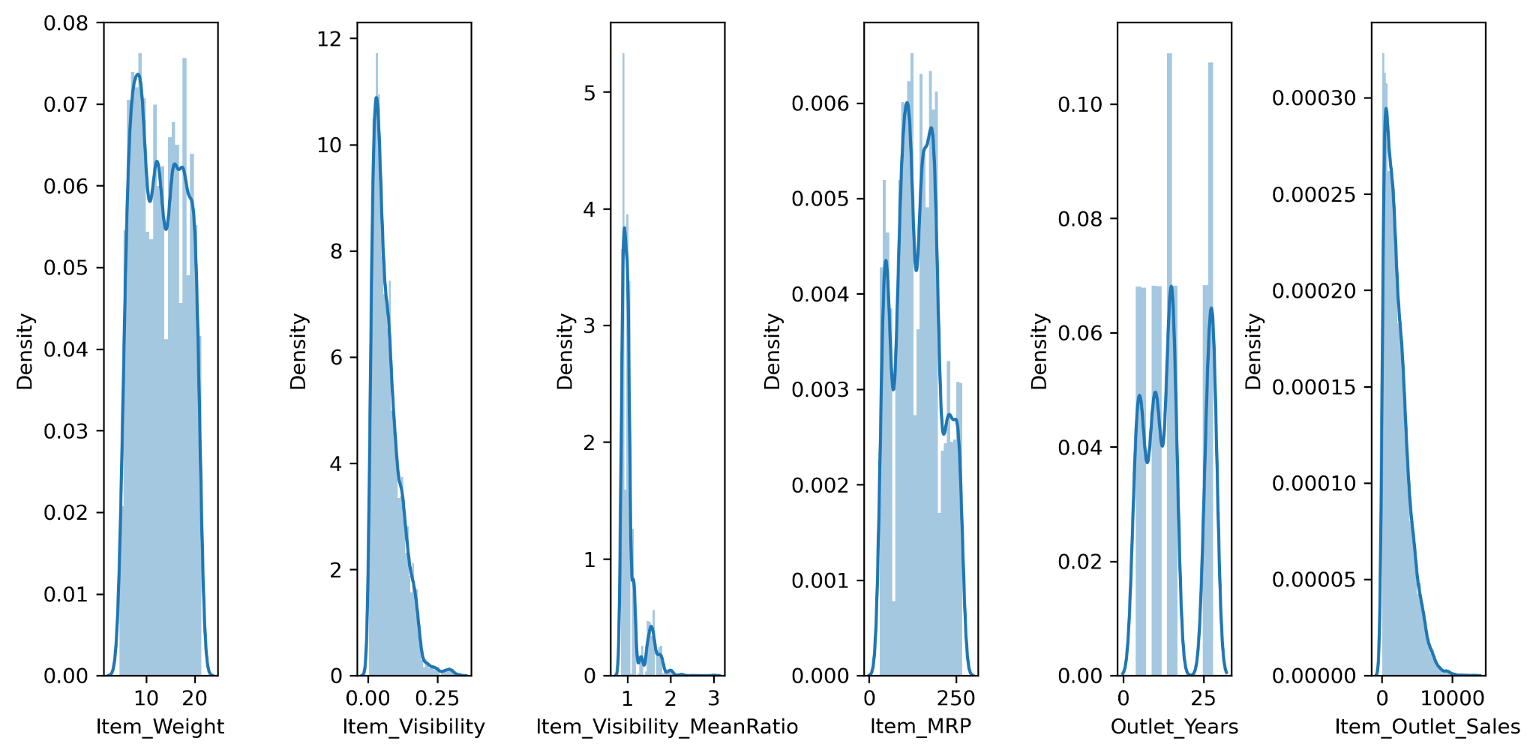
Feature Engineering
Final look on data

Slide 19
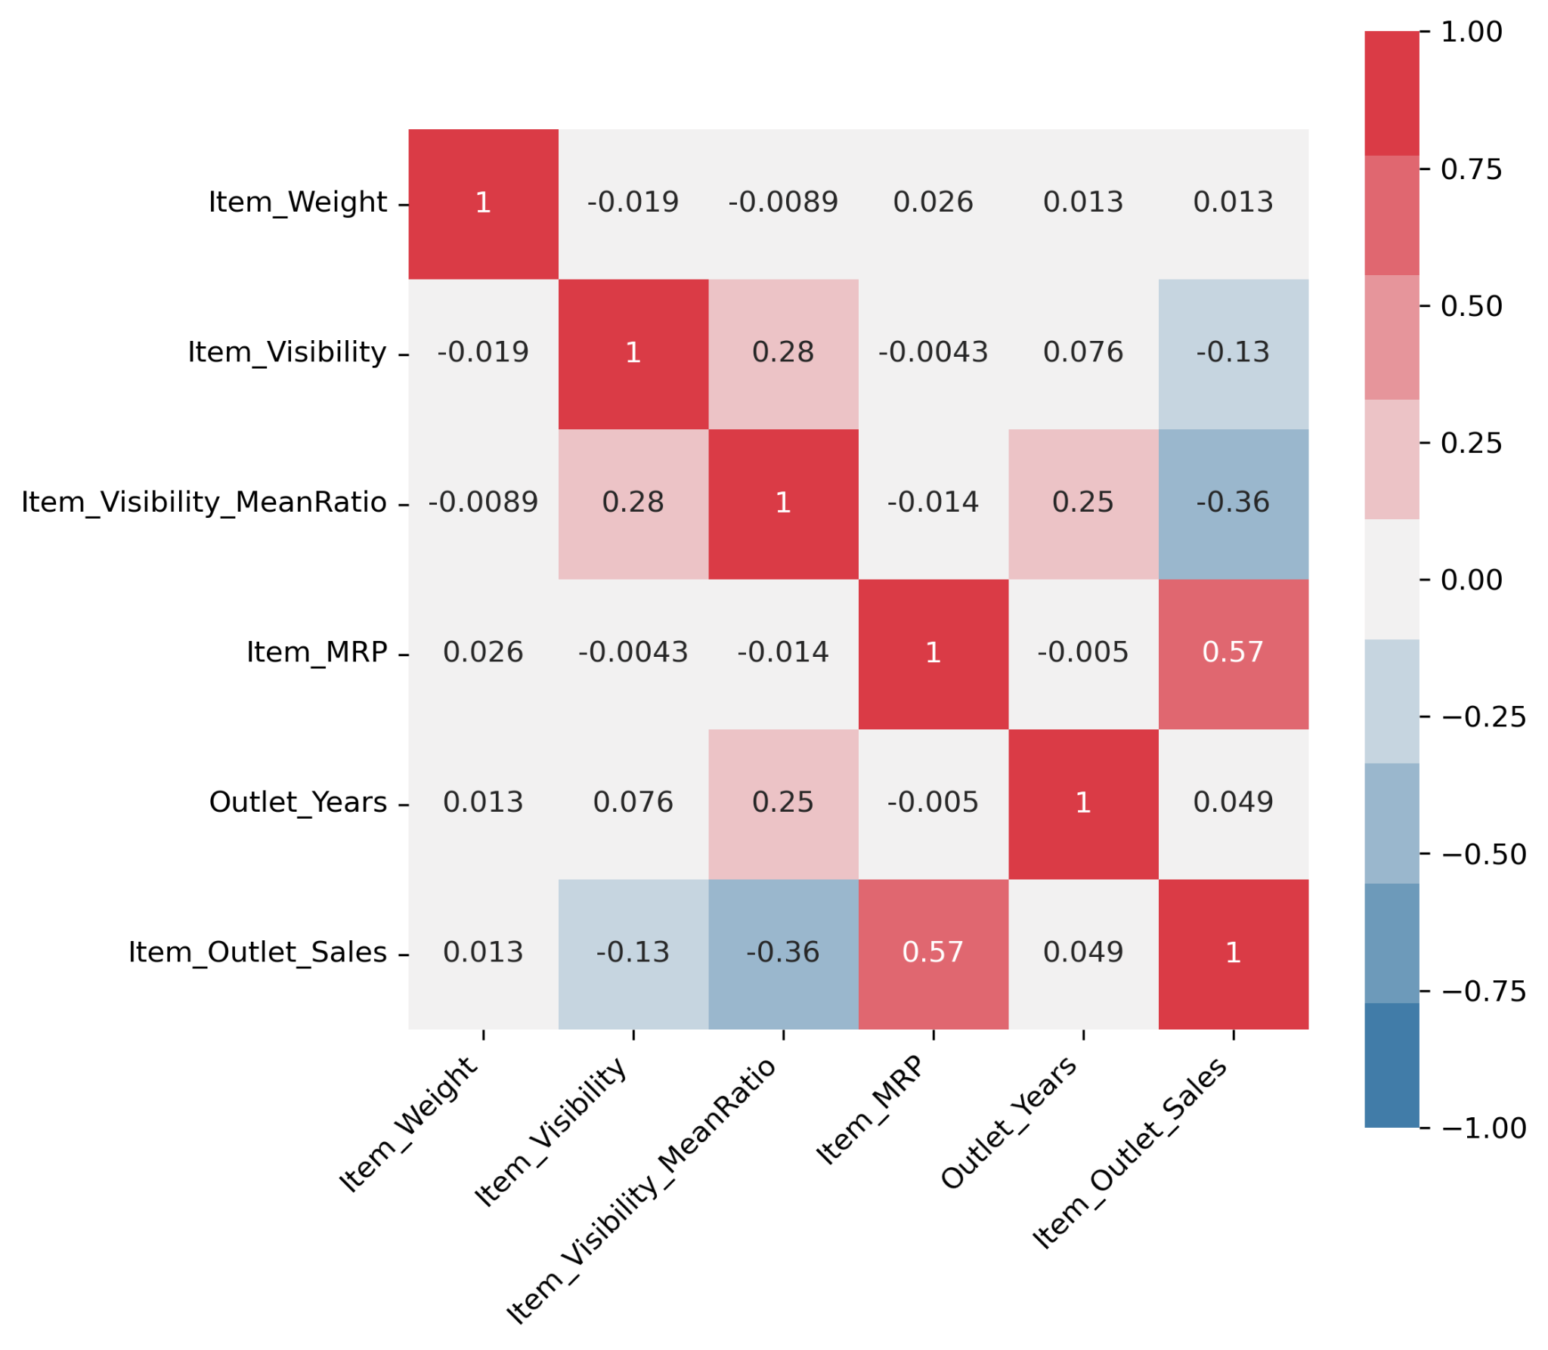
Feature Engineering
Final look on data
→ Drop Weight, Visibility, Years of operation as they are weakly correlated to Sales

Slide 20
Model building & Optimization
#1. Method & data
#2. Regression models
#3. Ensemble models
#4. Optimization

Slide 21
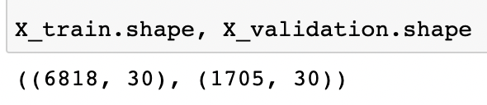
Model building
Method & data
Method
Train & validation data
Resampling method: Cross-validation
Validation size: 20% sample size
Number of folds: 10
Scoring: Negative MSE

Slide 22
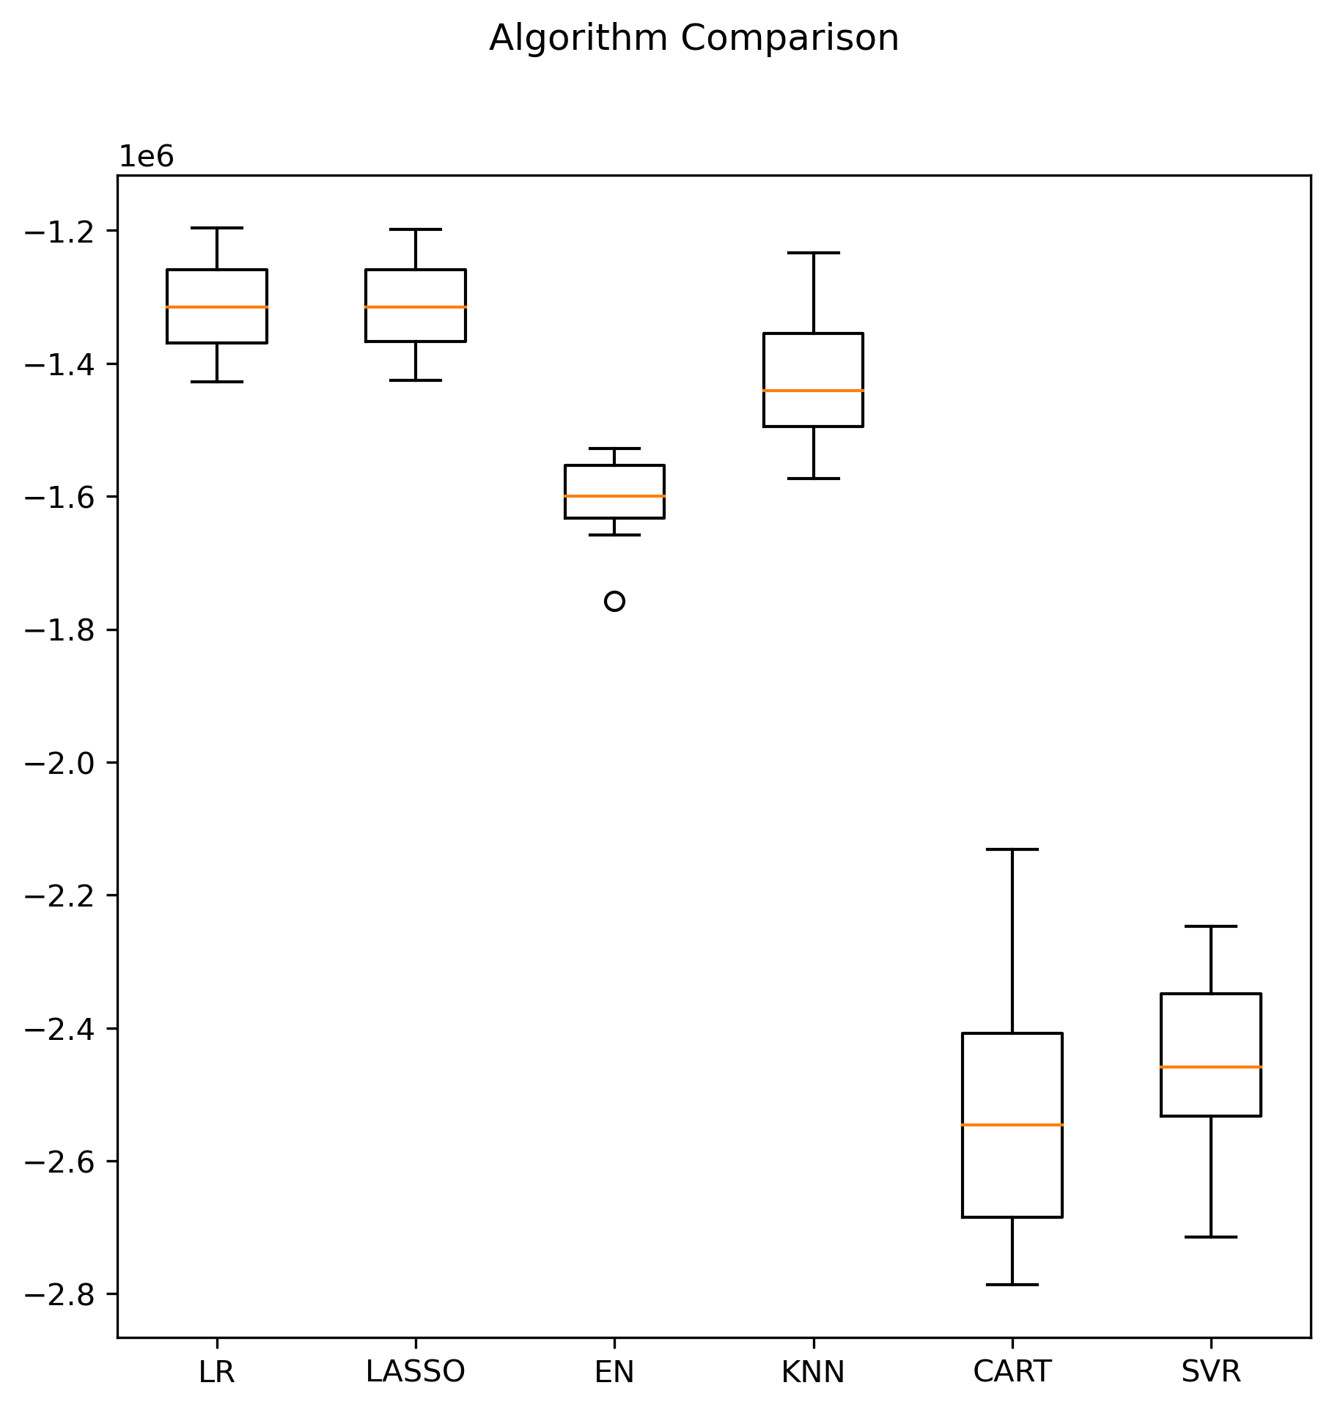
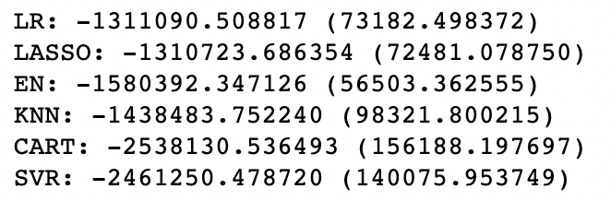
Model building
Regression models: Before scaling

Slide 23
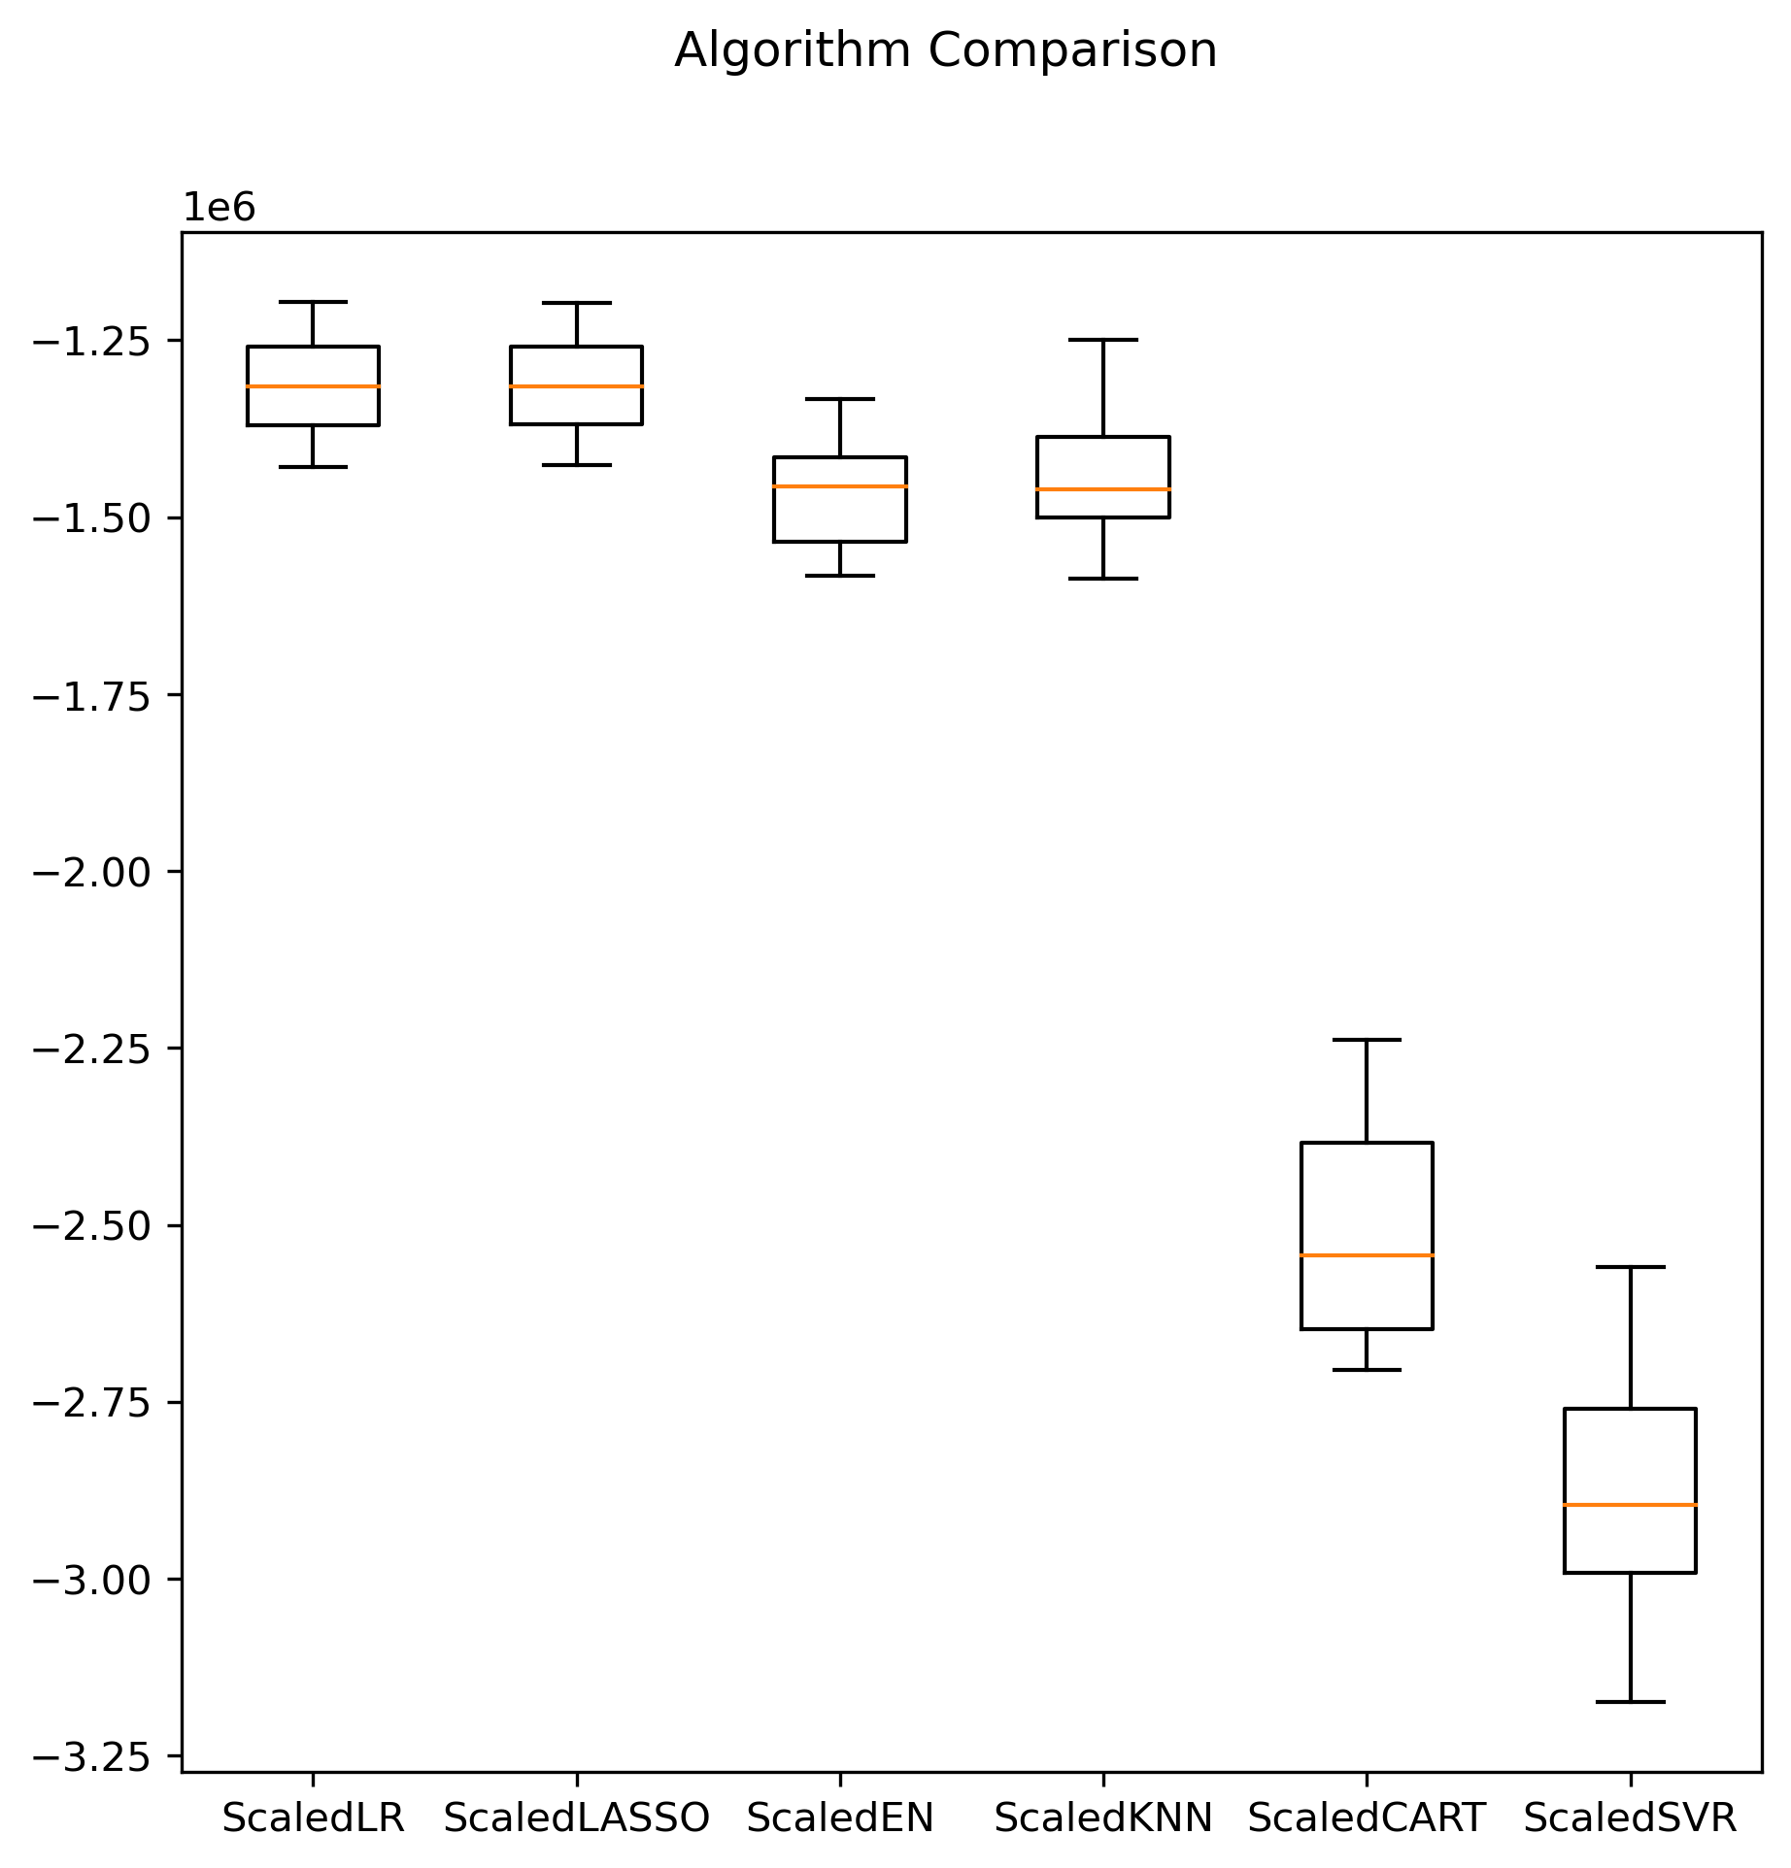
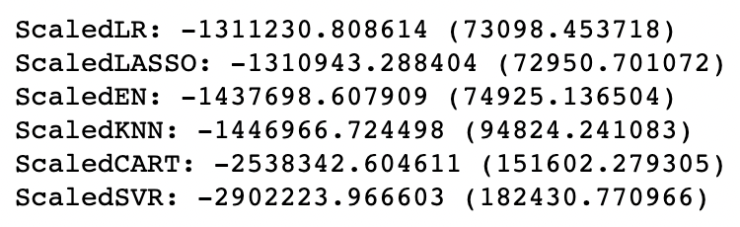
Model building
Regression models: After scaling

Slide 24
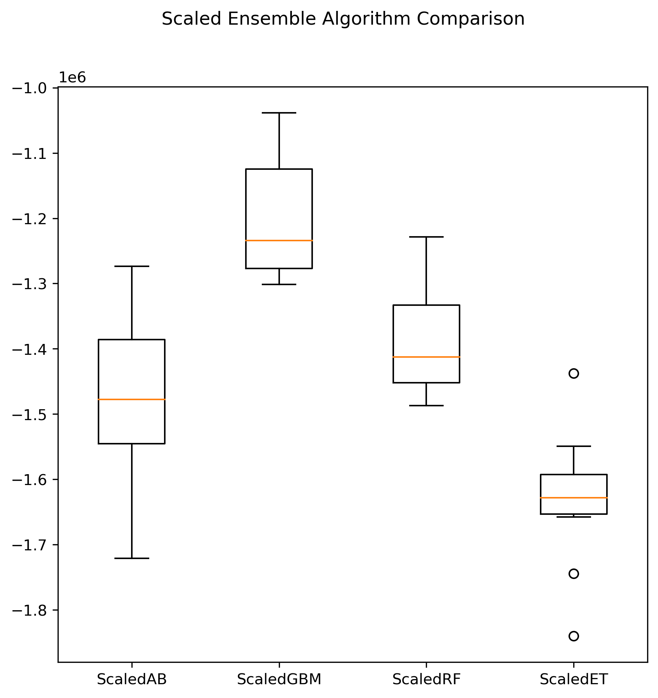
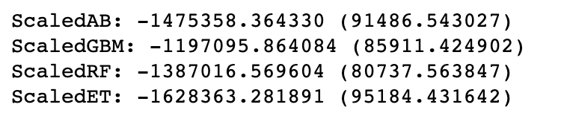
Model building
Ensemble models

Slide 25


Model building
Optimization
GBM return the best result
→ Choosing GBM for hyper parameter tuning using GridSearchCV to find best result
Before tuning
1st tuning
2nd tuning
Notes:
→ n-estimator reach maximum of the range
→ smaller learning rate or higher n-estimator might helps gain better result

Slide 26
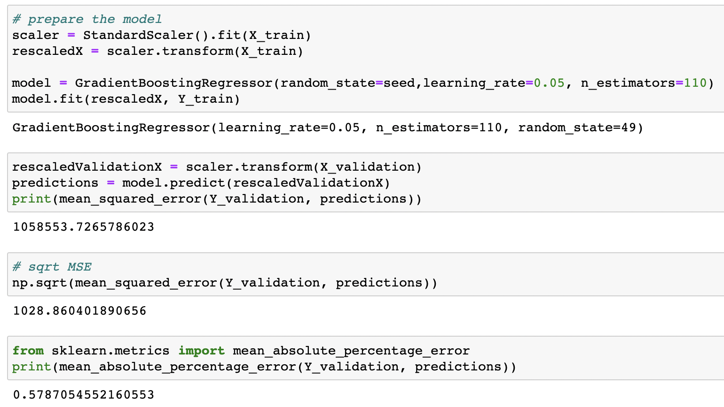
Model evaluation

